Slide 1
Multithread – Design Pattern
Swift Day 14

Slide 2
Multithread
NSThread
Grand Central Dispatch – GCD
NSOperatioinQueue

Slide 3
GCD
GCD - libdispatch, Apple’s library that provides support for concurrent code execution on multicore hardware on iOS and OS X:
GCD can improve your app’s responsiveness by helping run expensive tasks in the background.
GCD provides an easier concurrency model than locks and threads and helps to avoid concurrency bugs.

Slide 4
GCD Terminology
A synchronous function returns only after the completion of a task that it orders.
An asynchronous function, on the other hand, returns immediately, ordering the task to be done but not waiting for it. Thus, an asynchronous function does not block the current thread of execution from proceeding on to the next function.

Slide 5
GCD Terminology
Race Condition
Deadlock
Thread Safe
Context Switch

Slide 6
GCD Terminology
Serial vs Concurrent

Slide 7
Serial Queues

Slide 8
Concurrent Queues

Slide 9
Concurrency vs Parallelism
Notes:
Async – Sync – Context Switch

Slide 10
Main Queue
A special serial queue: all tasks will execute on the main thread, which is the only thread allowed to update your UI.

Slide 11
Global Dispatch Queues
QOS_CLASS_USER_INTERACTIVE: tasks that need to be done immediately in order to provide a nice user experience. Use it for UI updates, event handling and small workloads that require low latency. The total amount of work done in this class during the execution of your app should be small.
QOS_CLASS_USER_INITIATED: tasks that are initiated from the UI and can be performed asynchronously. It should be used when the user is waiting for immediate results, and for tasks required to continue user interaction.
QOS_CLASS_UTILITY: long-running tasks, typically with a user-visible progress indicator. Use it for computations, I/O, networking, continuous data feeds and similar tasks. This class is designed to be energy efficient.
QOS_CLASS_BACKGROUND: tasks that the user is not directly aware of. Use it for prefetching, maintenance, and other tasks that don’t require user interaction and aren’t time-sensitive.

Slide 12
Barriers(CustomQueue Only)
Notes:
Barrier – rào chắn xe lửa

Slide 13
GCD
Semaphores
Dispatch Groups (demo)

Slide 14
Design Patterns
Singleton
Observer
MVC
MVVM

Slide 15
Singleton
Singleton: only one instance exists for a given class and that there’s a global access point to that instance.

Slide 16
Singleton
Singleton on iOS:
NSUserDefaults.standardUserDefaults()
UIApplication.sharedApplication()
UIScreen.mainScreen()
NSFileManager.defaultManager()
…............................................

Slide 17
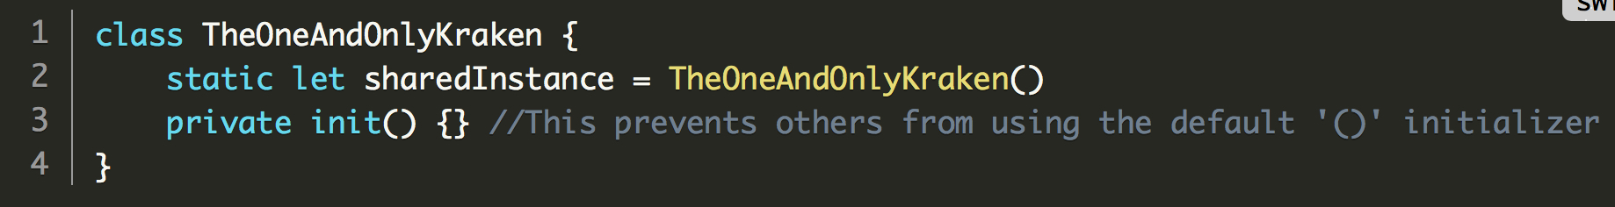
Singleton

Slide 18
Observer
Notifications
Key-Value Observing (KVO)

Slide 19
MVC

Slide 20
MVC
iOS MVC Problem: Massive or Mega View Controller

Slide 23
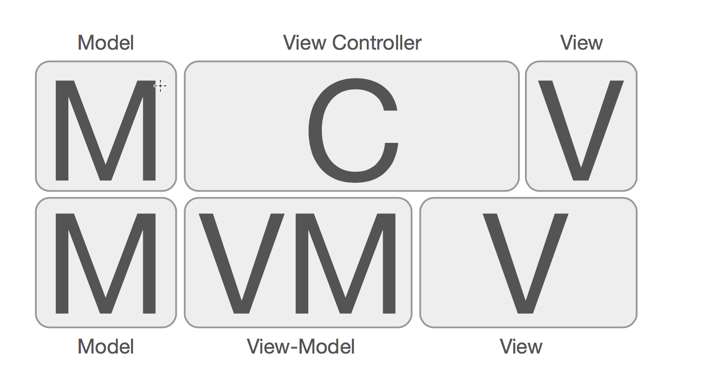
MVVM

Slide 24
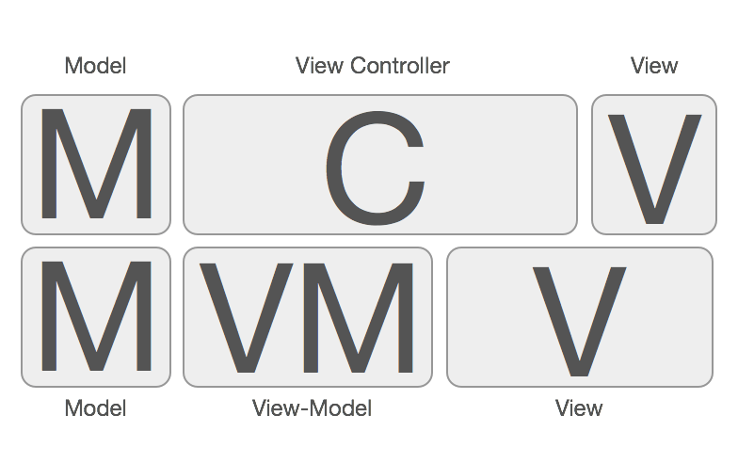

MVVM

Slide 25
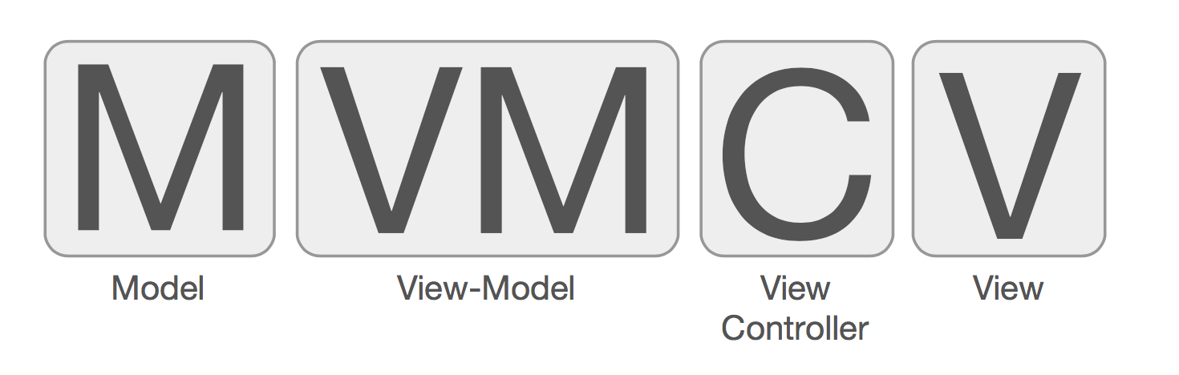
MVVM

Slide 26
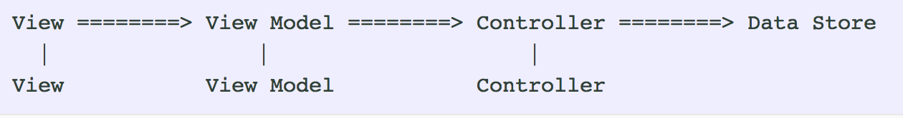
MVVM

Slide 27
MVVM
View’s Rules:
Views are allowed to access views and view models.
Views are not allowed to access controllers or model objects.
Views bind their display properties directly to view model properties.
Views pass user events to view models via Observer, or alternatively by calling methods on the view models.

Slide 28
MVVM
ViewModel’s Rules:
View models are allowed to access view models, controllers, and model objects.
View models are not allowed to access views or raw models.
View models convert model objects from controllers into observable properties on self, or other view models.
View models accept inputs from views or other view models which trigger actions on self, other view models, or controllers.

Slide 29
MVVM
Controllers:
Controllers are allowed to access other controllers, model objects, and raw models.
Controllers are not allowed to access view models or views.
Controllers coordinate model object access from other controllers or directly from system level raw data stores (network, file system, database, etc.).
Controllers vend asynchronous (or maybe better put time-agnostic) to view models or other controllers.
Have to stress again that these are not view controllers!

